Slide 1


Guidance Presentation
Event Reporting:
Near Misses
Press any key to continue

Slide 2
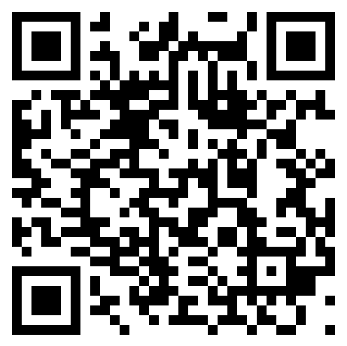
Adding a Near miss
Loading the first report screen
Loading the first report screen
Selecting the correct module
Filling in your details
Filling in the report
Review and submit
Scan the above QR code on your mobile device to open the Sphera first report page.
To open the first report screen on a PC or Laptop, goto the link below:
Reportasafetyevent.quanex.com
Prev
Next

Slide 3
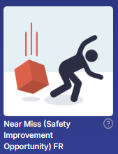
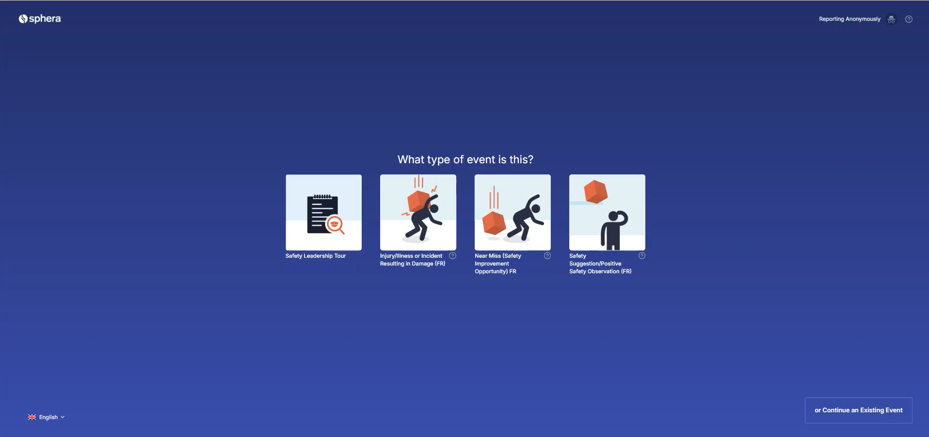
Adding a Near miss
2. Selecting the correct module
Loading the first report screen
Selecting the correct module
Filling in your details
Filling in the report
Review and submit
Once the website has loaded, select ‘Near Miss (Safety Improvement Opportunity)’
Prev
Next

Slide 4
Adding a Near Miss
3. Filling in your details
Loading the first report screen
Selecting the correct module
Filling in your details
Filling in the report
Review and submit
Do you have a Sphera account?
Click 'Yes' or 'No'
5. 5
#########
YES
NO
Prev

Slide 5
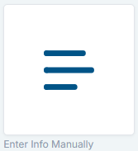
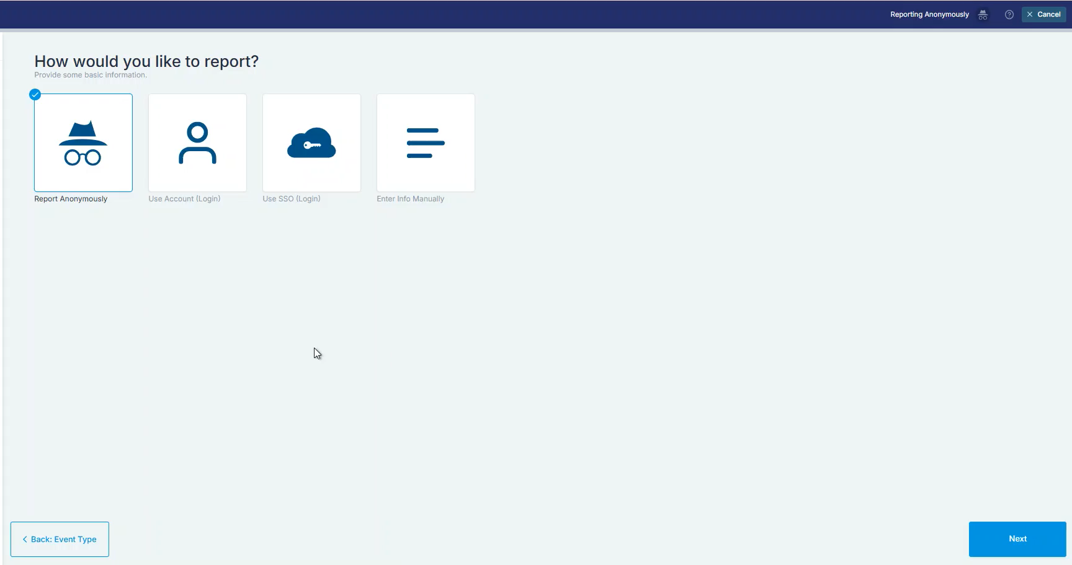
Adding a Near Miss
3. Filling in your details (unlicensed users)
Loading the first report screen
Selecting the correct module
Filling in your details
Filling in the report
Review and submit
When you arrive at the ‘How would you like to report?’ screen,
click ‘Enter Info Manually’
Then, enter your name, and click ‘Next’.
DO NOT INSERT ANY INFORMATION INTO 'Email' or 'Phone Number'
Prev
Next

Slide 6
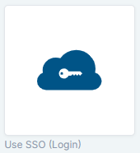
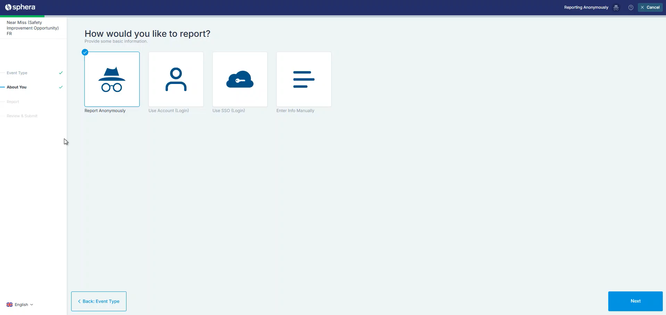
Adding a Near Miss
3. Filling in your details (licensed)
Loading the first report screen
Selecting the correct module
Filling in your details
Filling in the report
Review and submit
When you arrive at the ‘How would you like to report?’ screen,
click ‘Use SSO (Login)’
You will be forwarded to the Quanex single sign on protocol.
Once signed in, click 'Next'
Prev
Next

Slide 7
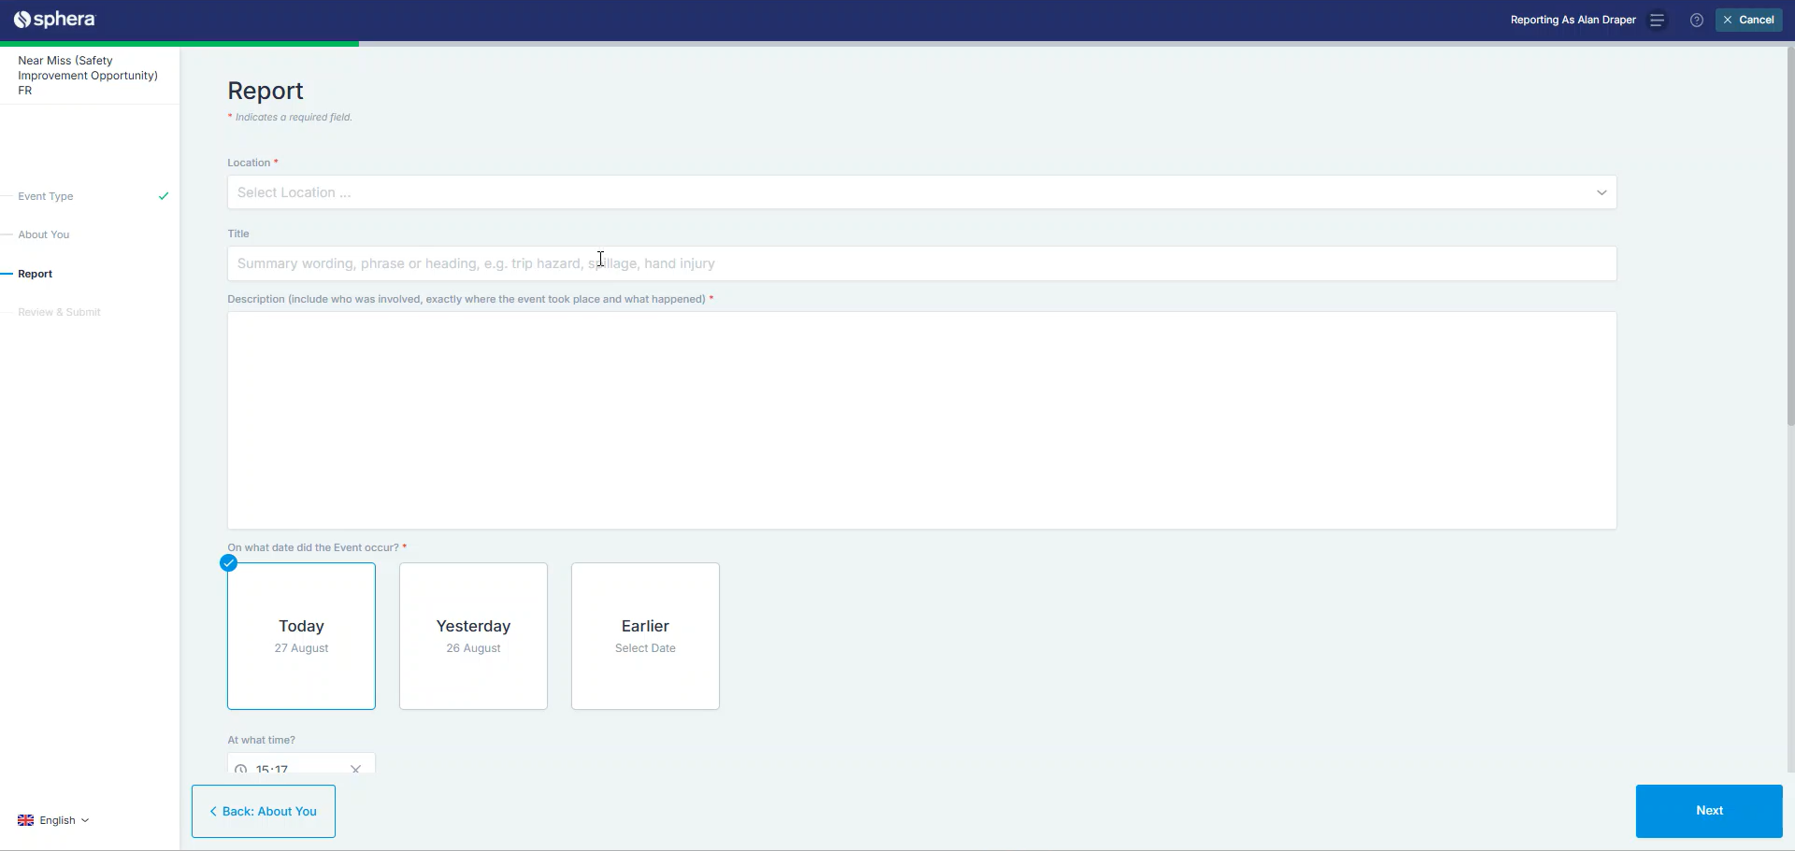
Adding a Near Miss
4. Filling in the report
Loading the first report screen
Selecting the correct module
Filling in your details
Filling in the report
Review and submit
Go ahead and fill in the necessary fields in the form.
Location | Your site location
Specific Location | The Department within the location
Title | A general view of the observation
Description | An in-depth detailed description
On what date did the event occur? | Date of the event
Prev
Next

Slide 8
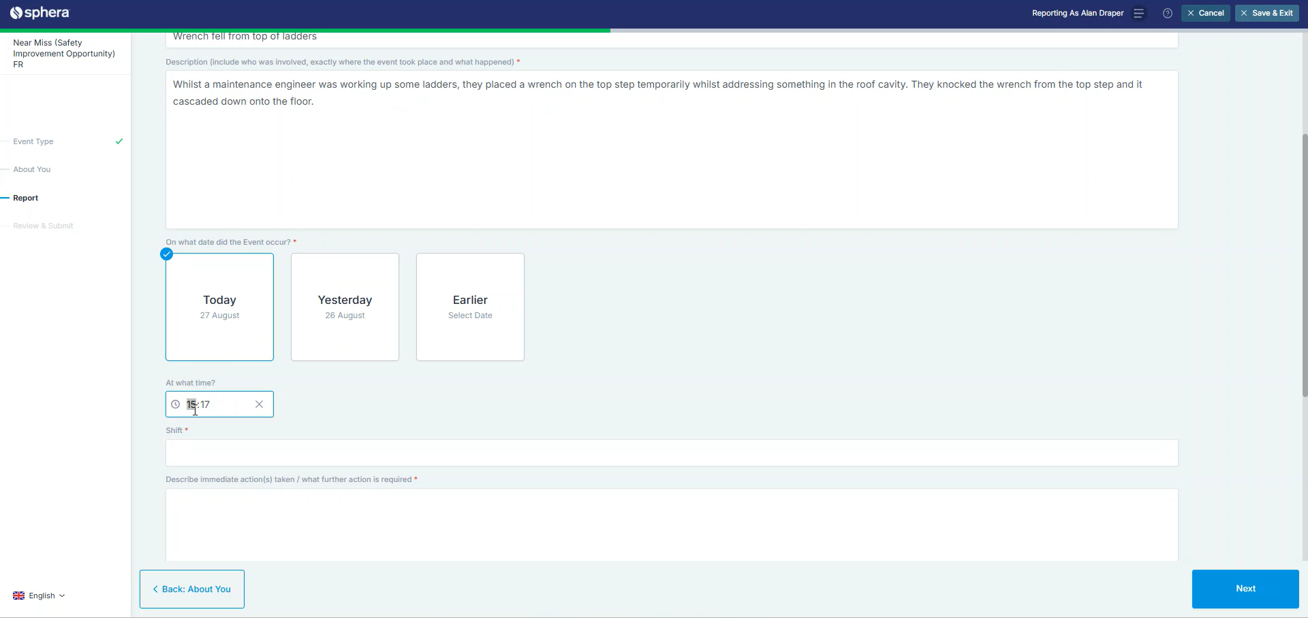
Adding a Near Miss
4. Filling in the report (cont.)
Loading the first report screen
Selecting the correct module
Filling in your details
Filling in the report
Review and submit
Scroll down to continue filling in the rest of the form. Then click ‘Next’
Date & Time | Fill these sections in.
Shift | Choose the shift which is the most applicable to the event
Describe what immediate action(s) were taken / what further action is required | Describe what actions were taken immediately after the event happened or whether further action needs to be taken.
Specific Activity | Find the closest match to the activity at the time of the event
Reported By | This is the person who raised the awareness of the event
Line Manager/Supervisor | This is the line manager/supervisor of the area in which the event occured.
Related Documents | Add all documents or images here
Prev
Next

Slide 9
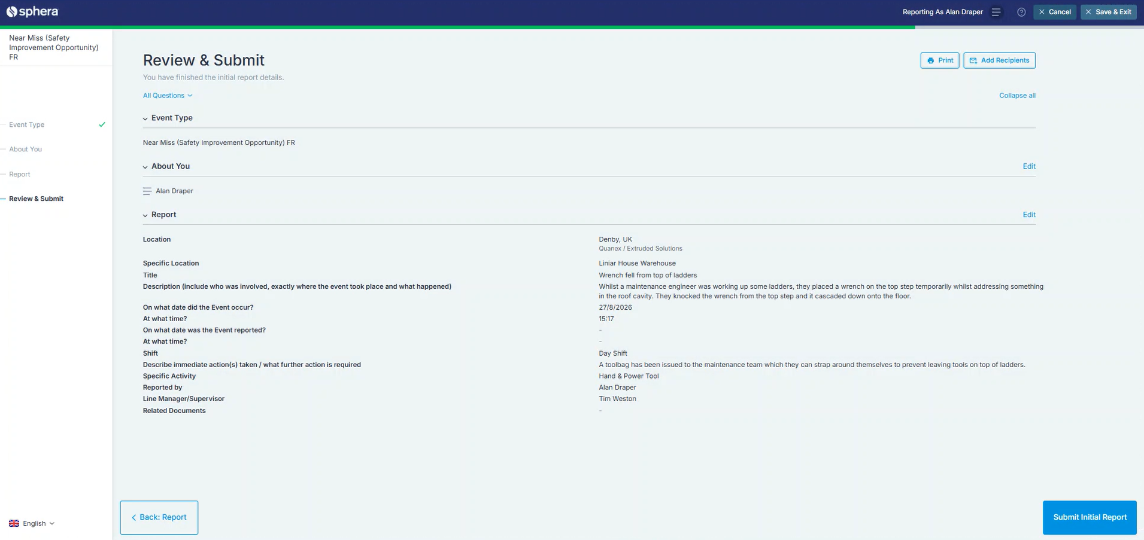
Adding a Near Miss
5. Review and Submit
Loading the first report screen
Selecting the correct module
Filling in your details
Filling in the report
Review and submit
You will be given an overview of your submission.
To complete, press ‘Submit Initial Report’
Prev

